Slide 1
Problem Statement
Design a digital taxi fare meter. 300 full turns of the wheel equal a 500m and a fare change. The driver can update the fare/km is multiples of Rs.10 from Rs 10 to Rs 50. The final fare will be calculated for a distance rounded up to the nearest 0.5km.

Slide 2
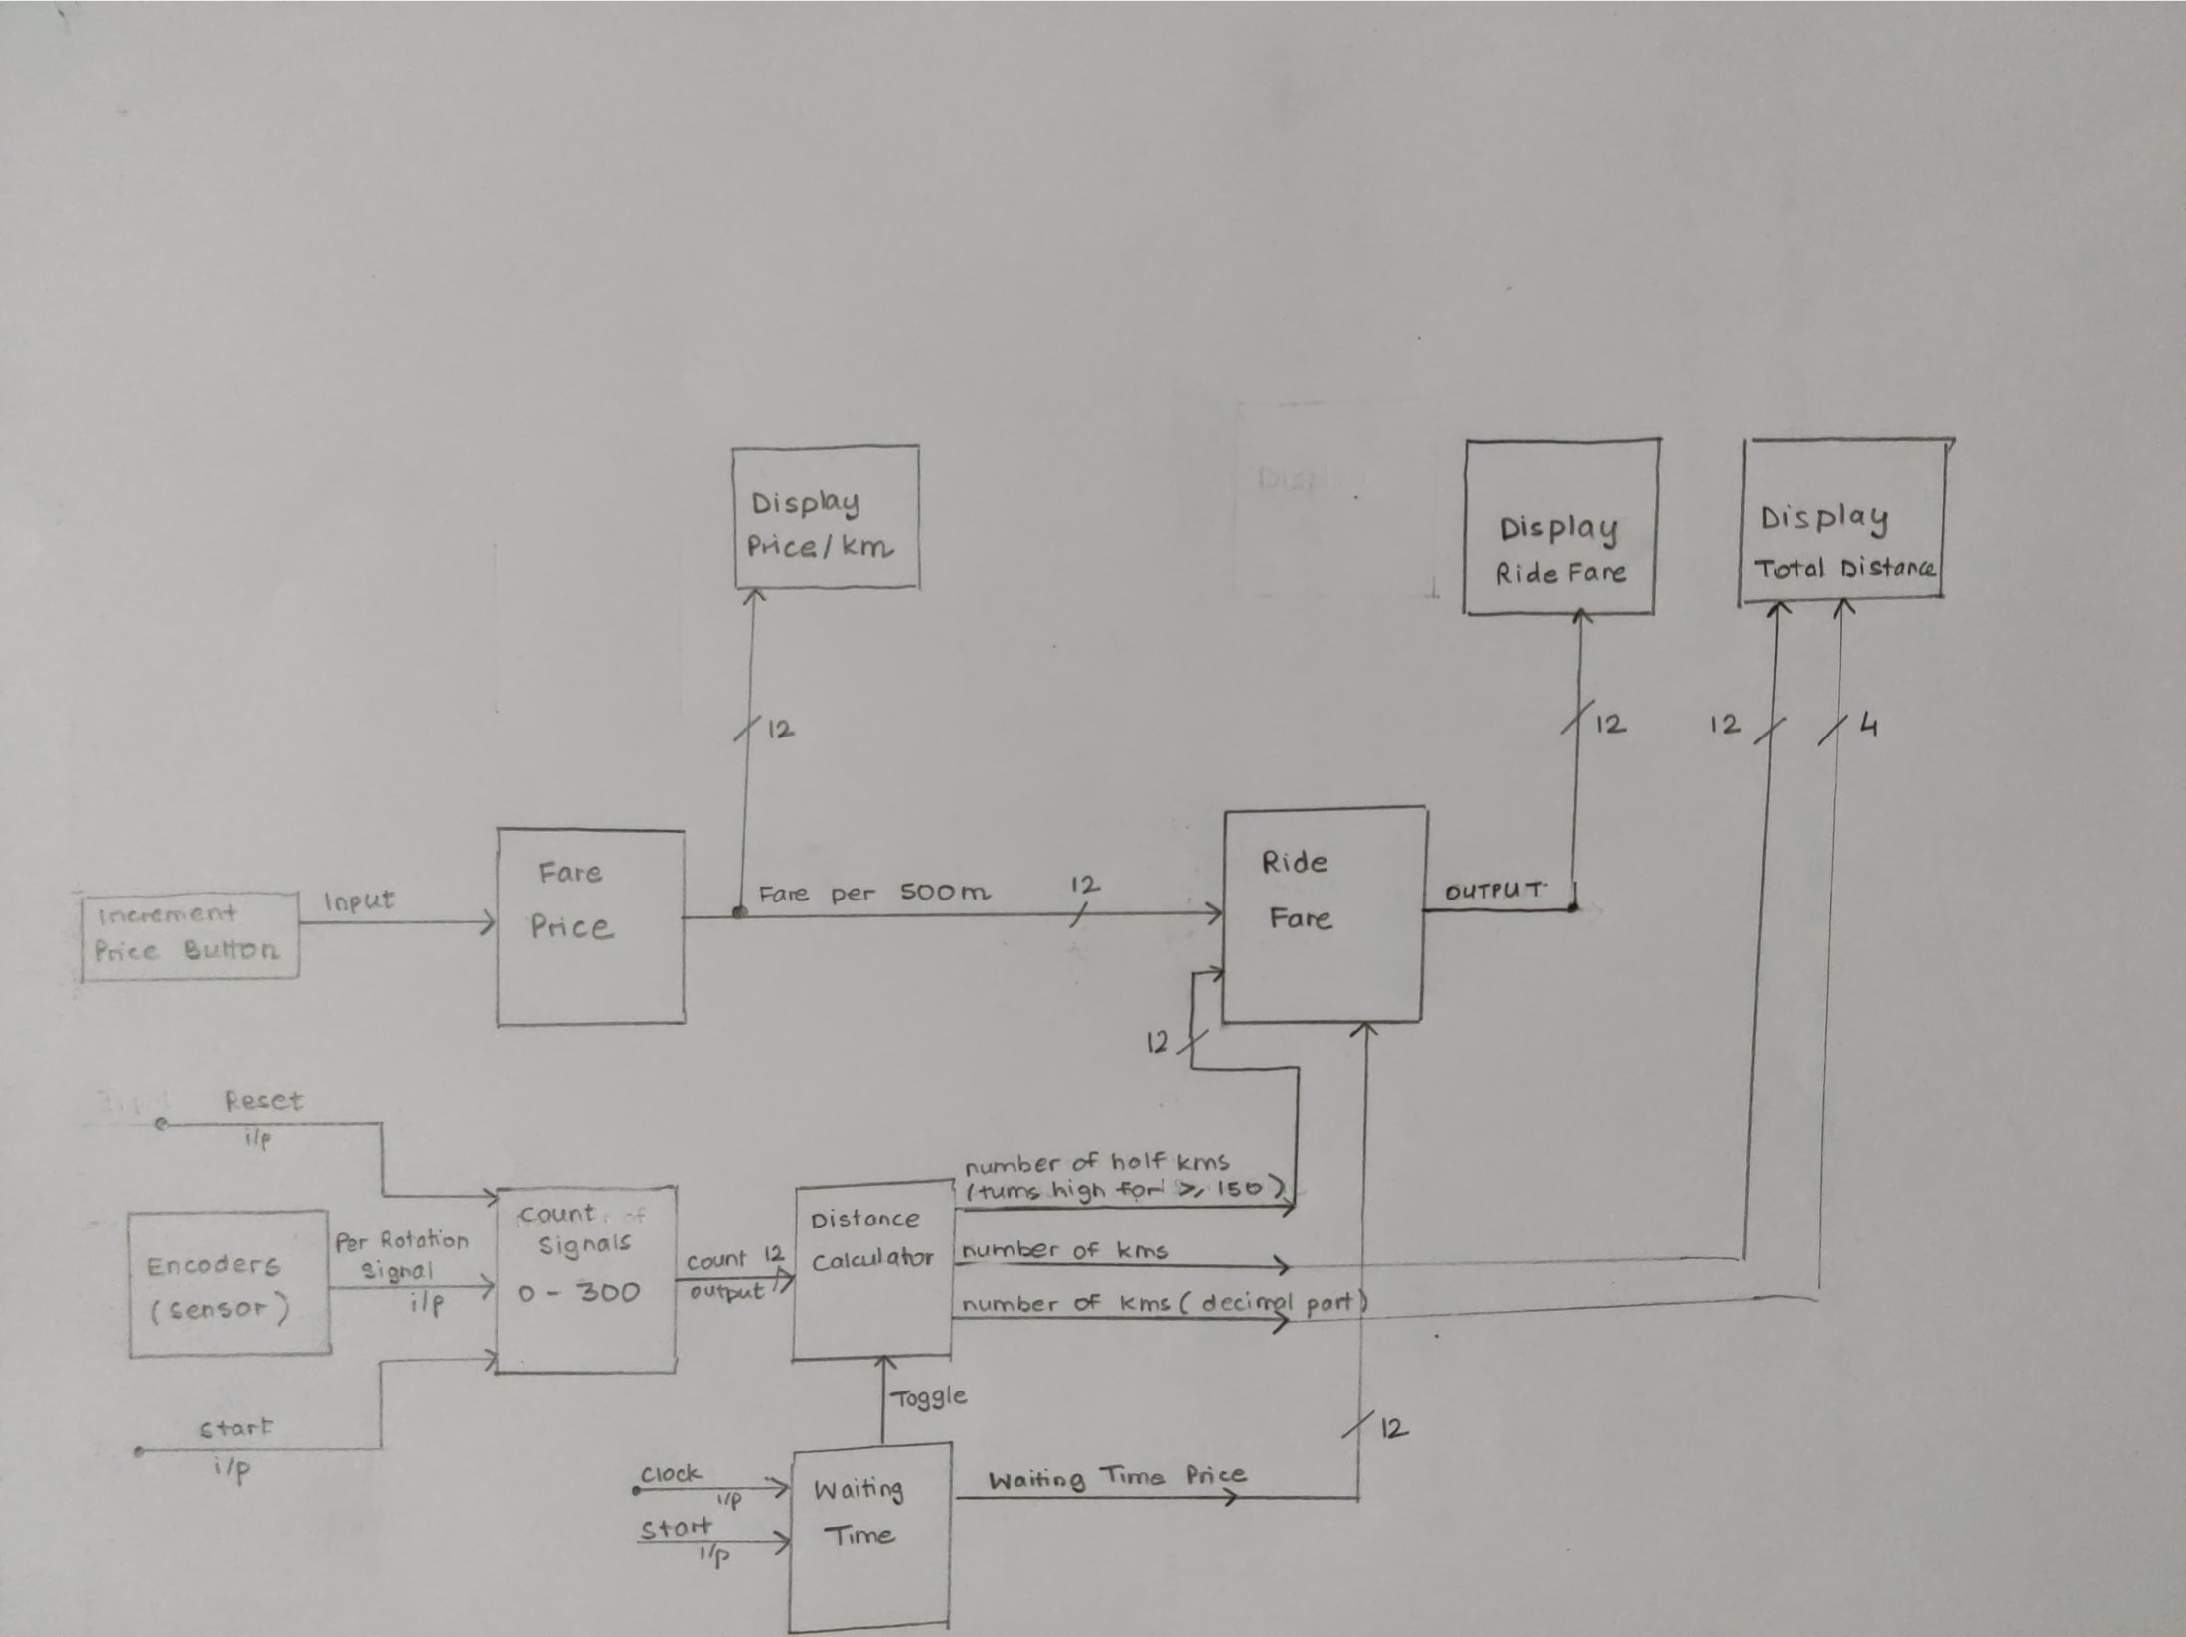
Top Level Diagram

Slide 3
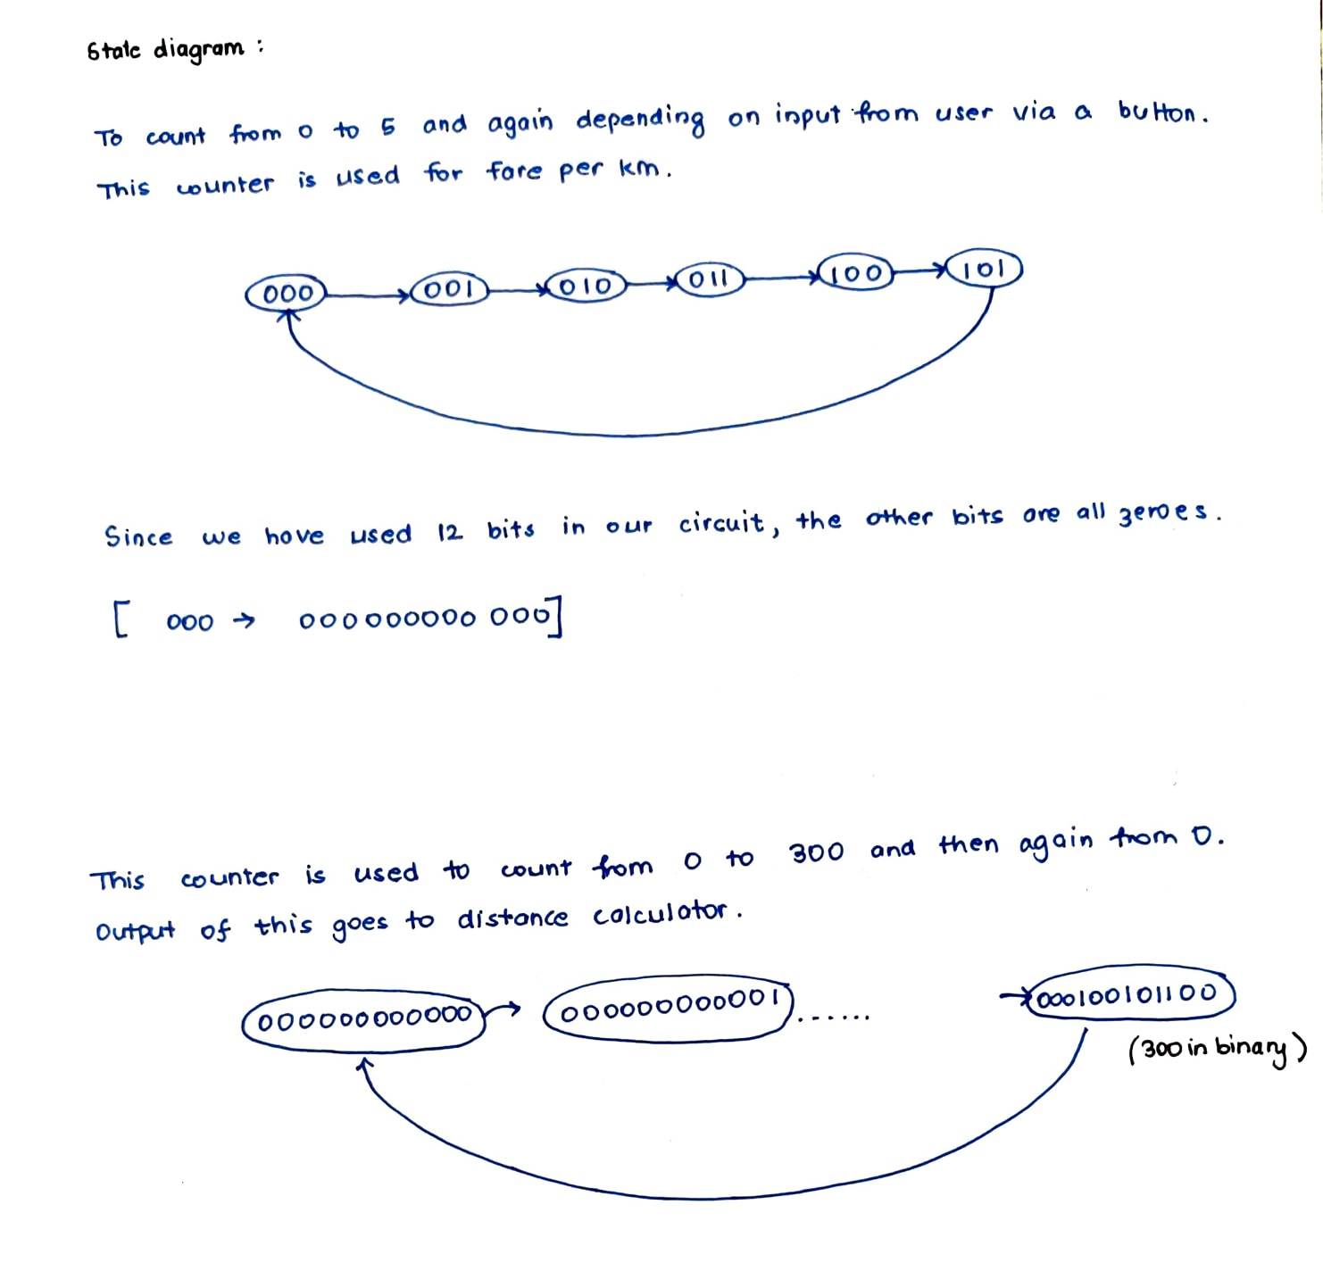

Slide 4
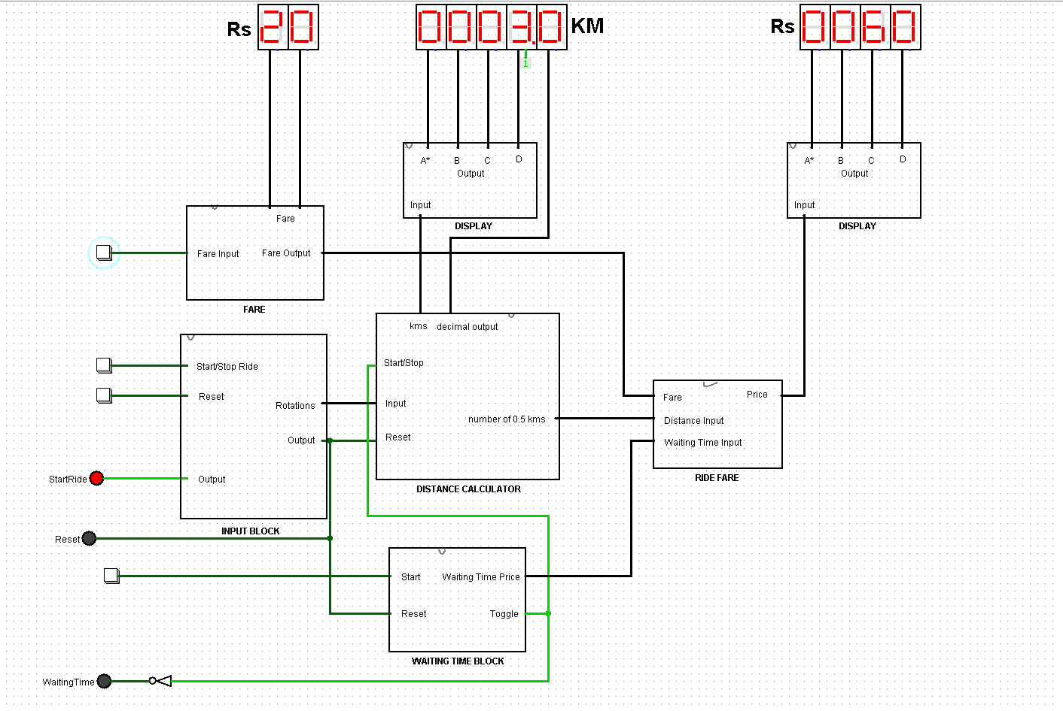
Sample Input/output

Slide 5
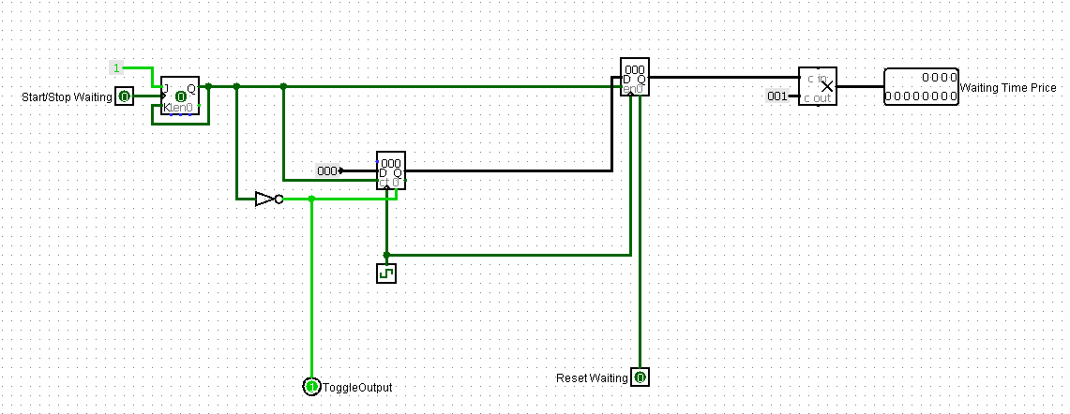
Waiting Time

Slide 6
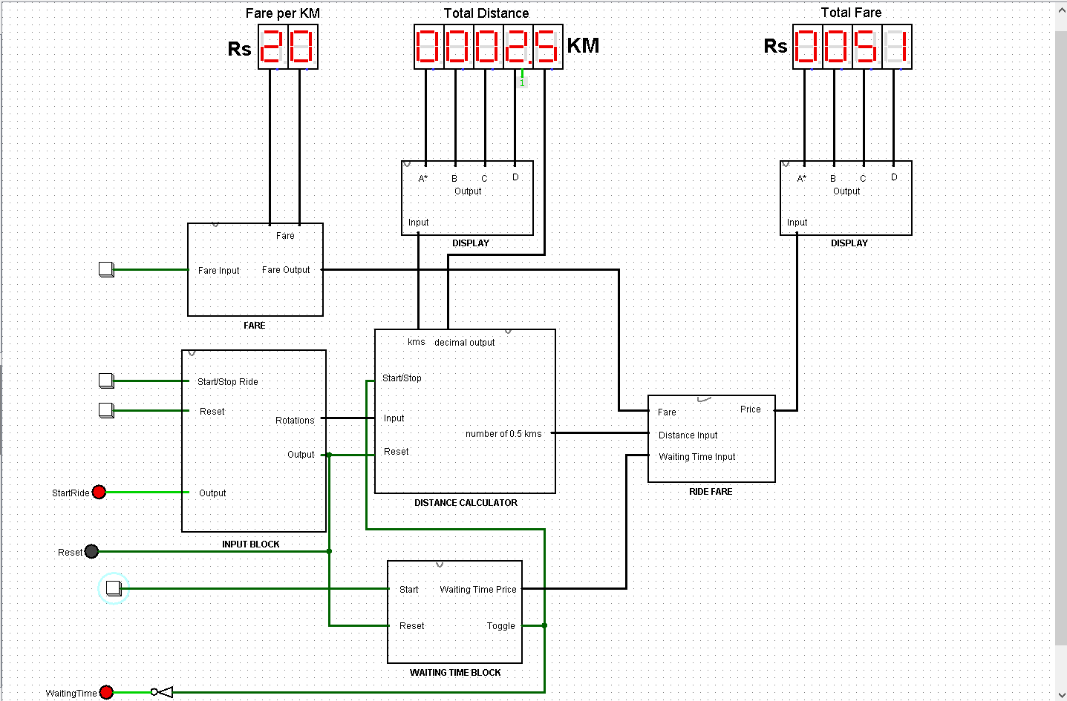
Waiting time output

Slide 7
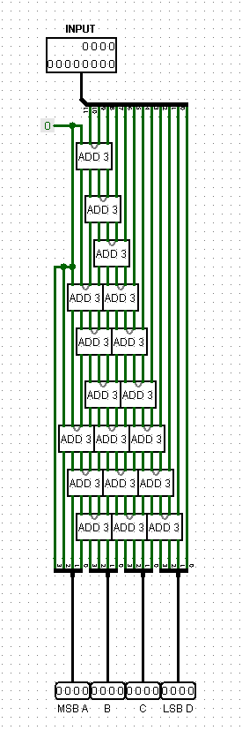
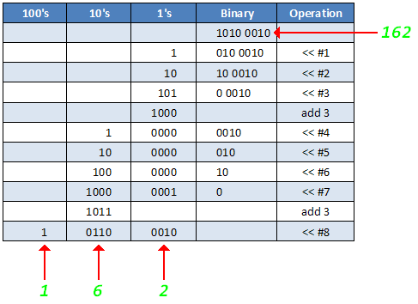
Double dabble algorithm
Display Block

